Slide 1

Intro to SVG
INFo6150 – Web Design and UX

Slide 2
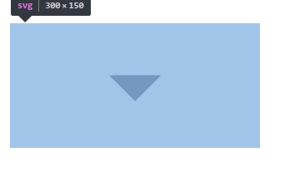
Introduction
Scalable Vector Graphics.
It defines vector-based graphics in XML format.
It creates a space in which 2D graphics can be defined.

Slide 3
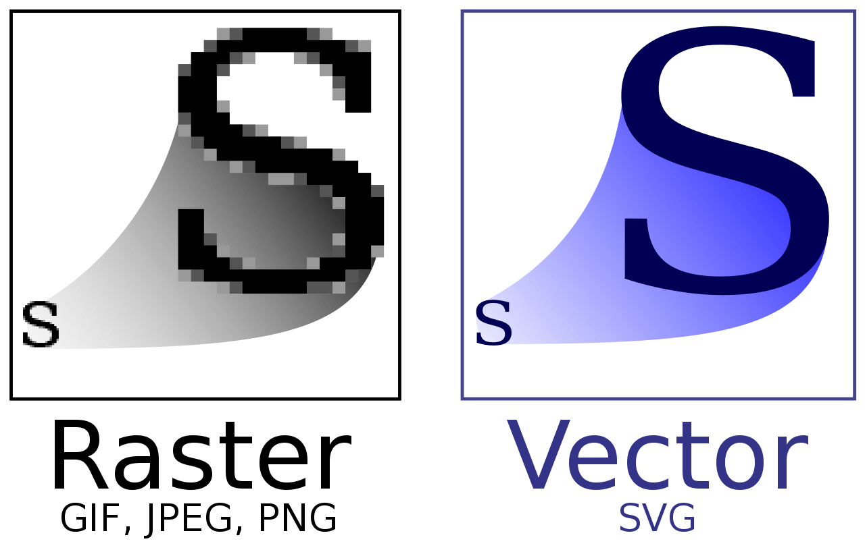
Why svg ?
OTHER IMAGE FORMATS:
Formats like .png and .jpg are raster images
Uses pixels to display images.
Images become grainy when zoomed

Slide 4
Why SVG ?
Is an image format.
Like HTML for 2d Graphics. Programmable images.
Vector Image can be scaled to any size without losing its resolution
Can integrate CSS (Styling as well as animation)

Slide 5
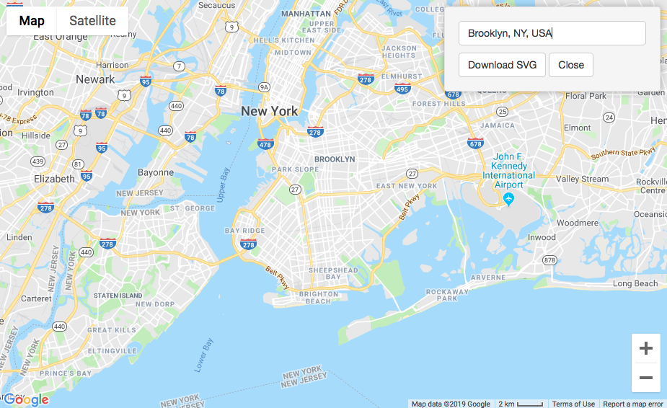
Example
Google Maps has SVG element to display the map.

Slide 6
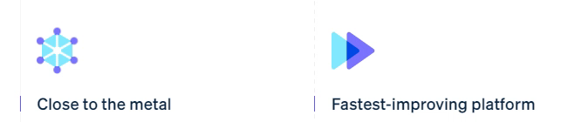
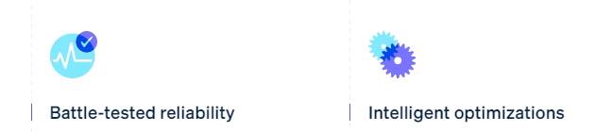
Example
Stripe.com uses SVG icons to create animations

Slide 7
SVG TAGs
The following are the tags present in SVG
<rect>
<circle>
<polygon>
<ellipse>
<path>

Slide 8
SVG Attributes
The following are the attributes of SVG
Height – Defines vertical length of object
Width – Determines width of an object
preserveAspectRatio – Defines how SVG container to deform if it is embedded in a container with different aspect ratio
viewbox – Defines the bound of SVG container

Slide 9
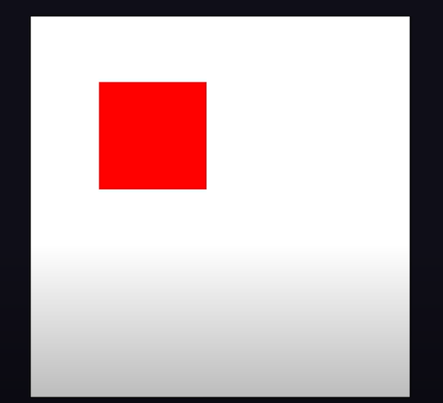
Sample SVG Code
Code:
<svg viewbox=“0 0 100 100”>
<rect
x =“10” y=“10”
width=“20%” height=“20”
fill = “red”
/>
</svg>

Slide 10

<path> Tag
The <path> SVG element is the generic element to define a shape. All the basic shapes can be created with a path element.
<svg viewBox="0 0 100 100">
<path d="M 10,30
A 20,20 0,0,1 50,30
A 20,20 0,0,1 90,30
Q 90,60 50,90
Q 10,60 10,30 z"/>
</svg>
Variables :
MoveTo: M, m
LineTo: L, l, H, h, V, v
Cubic Bézier Curve: C, c, S, s
Quadratic Bézier Curve: Q, q, T, t
Elliptical Arc Curve: A, a
ClosePath: Z, z

Slide 11
Resources
[YouTube] SVG Explained in 100 Seconds : Link
[MDN] SVG Elements : Link
<path> : Link
Path - <d> Attribute : Link
[WIKI] Scalable Vector Graphics - Link

Slide 12

Thank You
Pathak.pra@northeastern.edu
khimani.j@northeastern.edu

